Slide 1
Module 9: Association Studies
Hannah Carter
Department of Medicine
March 3, 2015

Slide 2
Questions?
Contact info
hkcarter@ucsd.edu
BRFII 3A14
Monday, Wednesday 1-3

Slide 3
Outline
Day 1:
Population genetics refresher
Why GWAS works
Genome wide association studies
Data
Case-Control Studies (Binary phenotype)
Quantitative Trait Locus Studies (Continuous phenotype)
Exercises
Day 2:
Missing heritability
Imputation & haplotypes
Exome wide association studies
Exercises

Slide 4
Population Genetics Primer
Genetic Diversity
Hardy Weinberg Equilibrium
Genetic Linkage

Slide 5
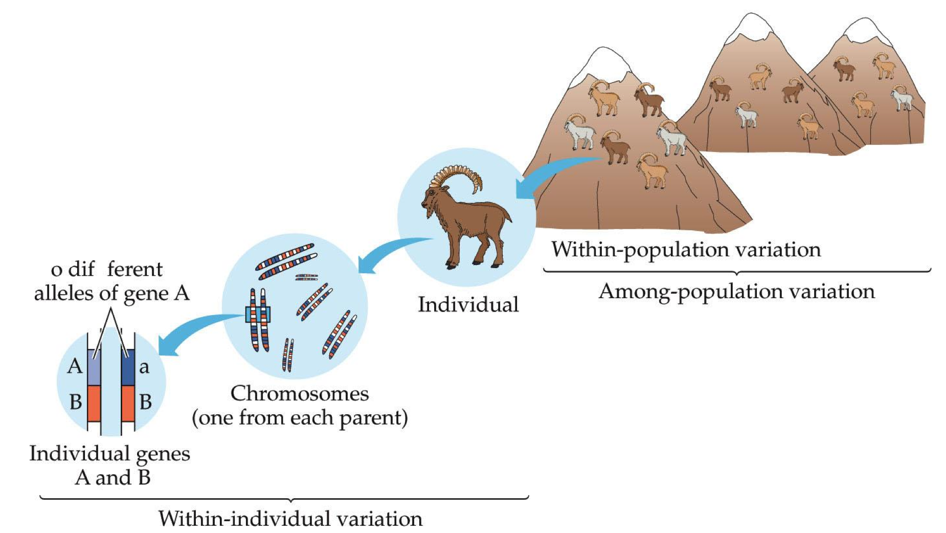
Genetic diversity
Two different alleles of gene A
Within population variation
Individual
Among population variation
Diploid: 1 copy of each chromosome from each parent
Genes A and B
Within-individual variation

Slide 6
Definitions
Locus
Describes a position or region in the genome. Can refer to a single nucleotide, a gene or a whole cytoband.
Allele
A particular nucleotide or nucleotide sequence at a genomic locus.
Cytoband
A subregion of a chromosome visible under a microscope after special staining
Polymorphism
A locus in the genome with > 1 allele
Genotype
Describes the pair of alleles carried by an individual at a genetic locus
Major / minor allele
Determined based on frequency in the population
AA = homozygous major allele
Aa = heterozygous
aa = homozygous minor allele

Slide 7
Genetic diversity within populations
Effective Population Size:
There are equal numbers of males and females, all of whom are able to reproduce.
All individuals are equally likely to produce offspring, and the number of offspring that each produces varies no more than expected by chance.
Mating is random.
The number of breeding individuals is constant from one generation to the next.
http://www.nature.com/scitable/topicpage/Genetic-Drift-and-Effective-Population-Size-772523
Number of polymorphic loci
Number of alleles at a given locus (can be > 2)
Heterozygosity at a locus
Number of individuals with one copy of the minor allele
Theta:
Estimates the population mutation rate
N_{e} represents “effective population size”
μ = mutation rate
Notes:
Essentially, anything that increases the variance among individuals in reproductive success (above sampling variance) will reduce N_{e}

Slide 8
Genetic diversity among populations
Differences in genotype and allele frequencies between populations
Example metrics
F_{st} – describes the amount of genetic variance due to population substructure
Genetic Distance – measures divergence of species or subpopulations. A small genetic distance means a recent common ancestor
Sequence divergence – proportion of nucleotide sites that differ between two subpopulations or species

Slide 9
Evolutionary processes that influence genetic diversity
Genetic Drift – random change in allele frequencies in a population from generation to generation due to finite population size.
Mutation – an error in the replication of DNA that causes a structural change in a gene. Only source of new genetic variation in populations (sex cells only).
Gene Flow – exchange of genetic information among population via migration of individuals.
Natural Selection – differential contribution of genotypes to the next generation due to differences in survival and reproduction.

Slide 10
Observed allele frequencies
Observed allele frequencies
Estimated from a sample of the population
2 Alleles per genotype
Allele frequencies:
f(A) = (116 + 40)/200 = 0.78 = p
f(a) = (2 + 40)/200 = 0.22 = q
Genotype: | AA | Aa | aa
Number | 58 | 40 | 2
Frequency | 0.58 | 0.4 | 0.02
N = 100 individuals
# Alleles in: | AA | Aa | aa
A | 116 | 40 | 0
a | 0 | 40 | 2
N = 200 alleles

Slide 11
Expected allele frequencies
Aa
Aa
Aa
Aa
Mendelian inheritance
1 allele from each parent
Inherited at random and independently
AA
aa
Aa
Aa
Aa
Aa
Aa
Aa
Thus given knowledge of the allele frequencies in the population we would have expectations about the relative abundance of homozygotes and heterozygotes in the next generation

Slide 12
Expected allele frequencies
Much of population genetics involves manipulations of equations that have a base in either probability theory or combination theory.
Rule 1: If you account for all possible events, the probabilities sum to 1. [e.g., p + q = 1 for a two-allele system].
Rule 2: The probability that two independent events occur is the product of their individual probabilities. [e.g., probability of a homozygote with aa genotype is q*q = q²].
Thus, under “ideal” conditions, expected genotype frequencies are p² for AA, 2pq for Aa, and q² for aa; and the genotype frequencies sum to 1 such that:
p² + 2pq + q² = 1 (Hardy Weinberg Equilibrium)

Slide 13
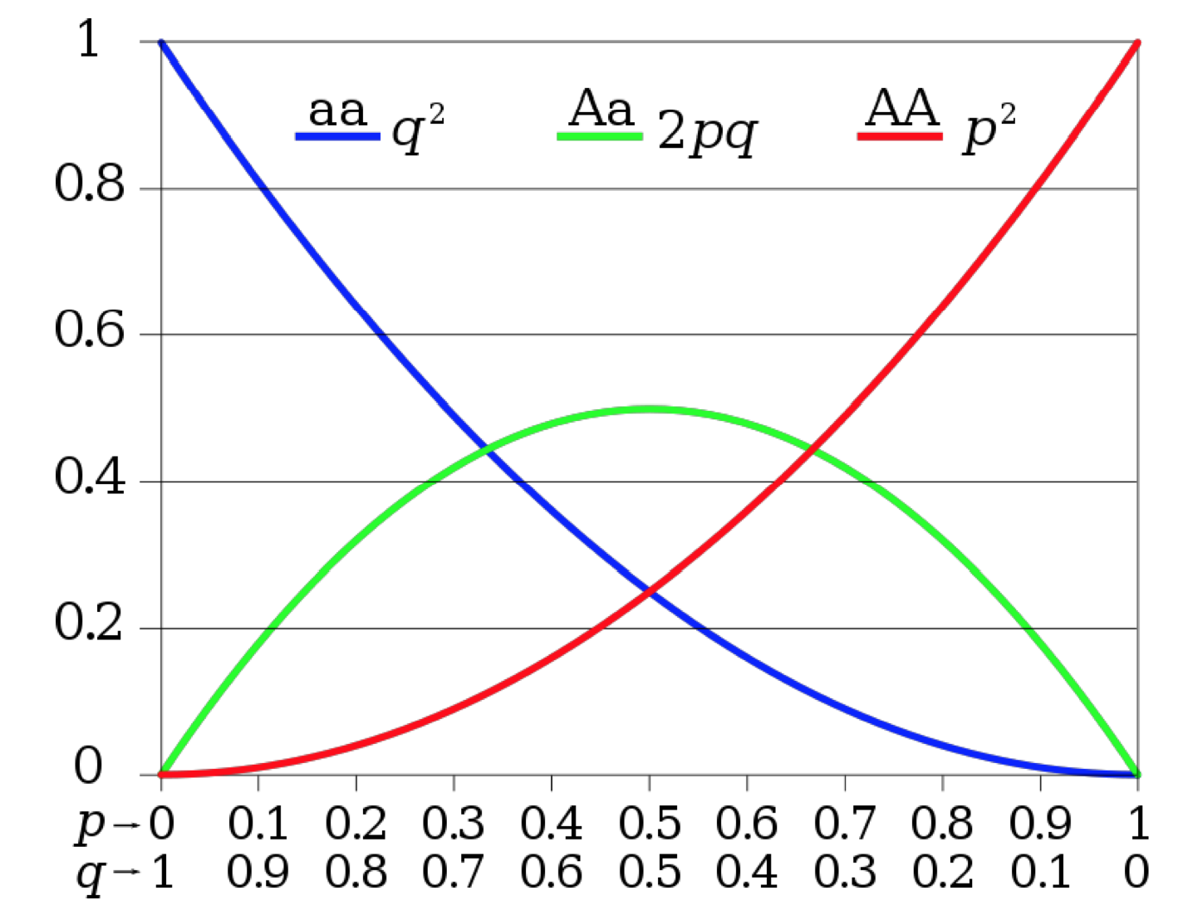
Hardy Weinberg Equilibrium
Assumptions
organisms are diploid
only sexual reproduction occurs
generations are non overlapping
mating is random
population size is infinitely large
allele frequencies are equal in the sexes
there is no migration, mutation or selection
Reasons why a measured genotype might deviate HWE:
Non-random mating / inbreeding
Population substructure
Purifying select <- can indicate a disease allele

Slide 14
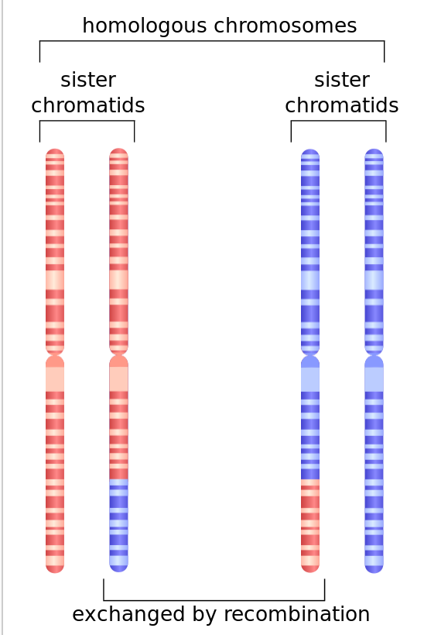
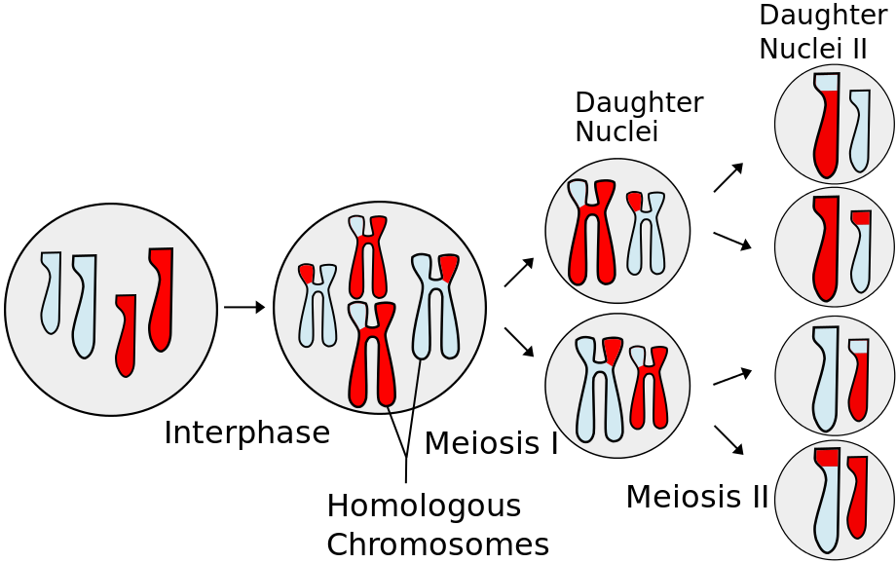
Genetic Linkage
Homologous recombination
Meiosis
Gametogenesis in Eukaryotic cells
Generates diversity in a population

Slide 15
Linkage & Linkage Disequilibrium
Linkage: The presence of 2 or more loci with limited recombination between them
LD: Nonrandom association of two or more alleles that descend from the same ancestral chromosome
Notes:
Linkage
Centimorgan – 1cm represents a genetic distance of expected average number of intervening chromosomal crossovers in a single generation is 1%

Slide 16
Measures of Linkage Disequilibrium
Haplotype | Frequency
A₁B₁ | x₁₁
A₁B₂ | x₁₂
A₂B₁ | x₂₁
A₂B₂ | x₂₂
Allele | Frequency
A₁ | p₁=x₁₁+x₁₂
A₂ | p₂=x₂₁+x₂₂
B₁ | q₁=x₁₁+x₂₁
B₂ | q₂=x₁₂+x₂₂
Deviation of a the observed frequency of a haplotype from the expected is Linkage Disequilibrium (D)
"two alleles are in LD" : D ≠ 0
“linkage equilibrium” : D = 0
If A & B are independent, then x₁₁ = p₁q₁
D = x₁₁ – p₁q₁
 | A₁ | A₂
B₁ | x₁₁ = p₁q₁ + D | x₂₁ = p₂q₁ - D | q₁
B₂ | x₁₂ = p₁q₂ - D | x₂₂ = p₂q₂ + D | q₂
 | p₁ | p₂
Probabilities must add to 1
p₁q₁+p₁q₂+p₂q₁+p₂q₂ = 1, x₁₁+x₁₂+x₂₁+x₂₂ = 1
D will be 0 if any allele frequencies are 1 or 0, and will be maximal if allele frequencies are 0.5
D’ = normalized LD
D’ attempts to compensate for sensitivity to allele frequencies by normalizing on the theoretical maximum given observed frequencies
r² = correlation coefficient between loci
controls for allele frequencies

Slide 17
Example
Haplotype | Frequency
A₁B₁ | x₁₁= 0.23
A₁B₂ | x₁₂ = 0.27
A₂B₁ | x₂₁ = 0.10
A₂B₂ | x₂₂ = 0.40
Allele | Frequency
A₁ | p₁=0.21+0.27=0.5
A₂ | P₂=0.10+0.40=0.5
B₁ | q₁=0.23+0.10=0.33
B₂ | q₂=0.27+0.40=0.67
 | A₁ | A₂
B₁ | x₁₁ = p₁q₁ + D | x₂₁ = p₂q₁ - D | q₁
B₂ | x₁₂ = p₁q₂ - D | x₂₂ = p₂q₂ + D | q₂
 | p₁ | p₂
 | A₁ | A₂
B₁ | 0.23 = 0.165 + D | 0.10 = 0.165 - D | q₁
B₂ | 0.27 = 0.335 - D | 0.40 = 0.335 + D | q₂
 | p₁ | p₂
D is dependent on allele frequencies
D’ attempts to compensate for this by normalizing on the maximum achievable haplotype frequency given the allele frequencies
D = 0.065
D_{max}= min(0.335, 0.165) , D > 0
D’ = 0.065 / 0.165 = 0.394

Slide 18
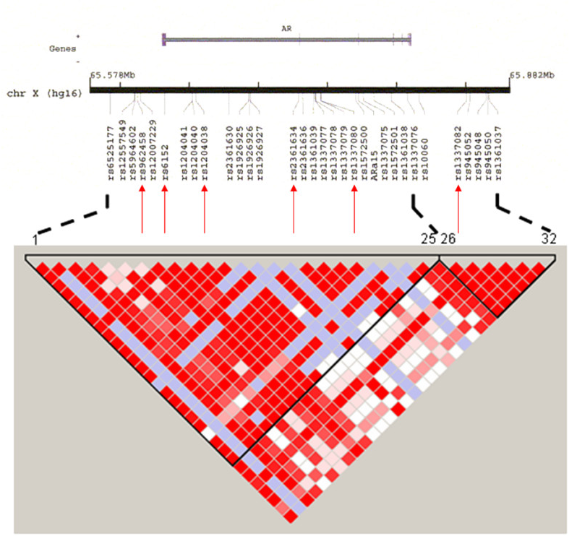
Visualizing LD
Haploview
http://www.broadinstitute.org/scientific-community/science/programs/medical-and-population-genetics/haploview/haploview

Slide 19
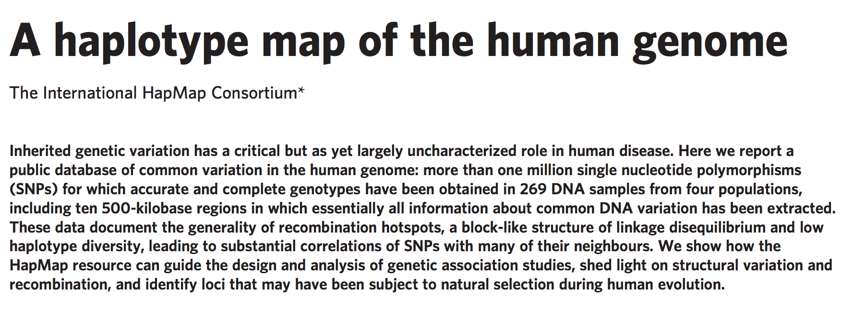
HapMap Project
Project goal: Generate a haplotype map of the human population to serve as a resource for genetic association testing
Notes:
269 individual from 4 populations
Find a marker in every 5KB with MAF > 5%

Slide 20
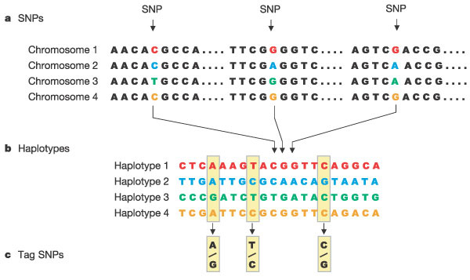
HapMap Project
Single nucleotide polymorphisms(SNPs) are identified in DNA samples from multiple individuals.
Adjacent SNPs that are inherited together are compiled into "haplotypes."
"Tag" SNPs within haplotypes are identified that uniquely identify those haplotypes.
Notes:
Condensed representation of the human genome
Captures common variation

Slide 21
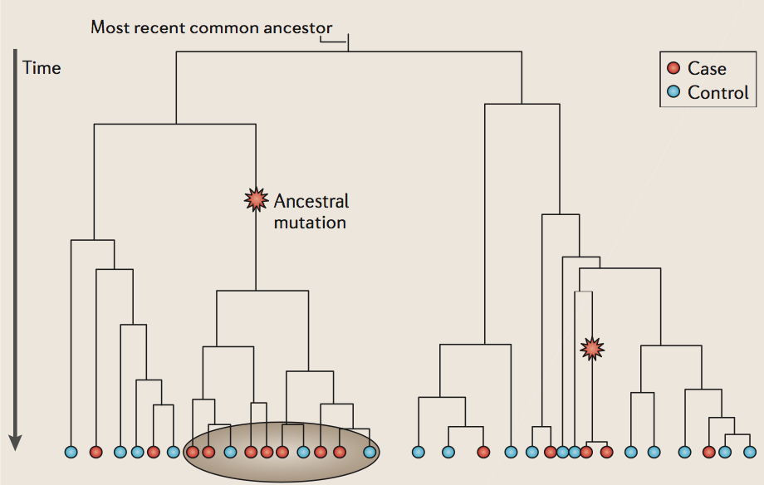
Genome-wide association studies
Goal: Identify genetic loci that correlate with a phenotype in the population
Case-control studies
Type1&2 diabetes
Quantitative trait association studies
Height, BMI
Case
Control
Notes:
You assemble a group of individuals with the phenotype of interest
You test a series of SNPs to see if an allele is overrepresented in the cases relative to the controls
This localizes a region of the genome that presumably carries a mutation related to the trait

Slide 22
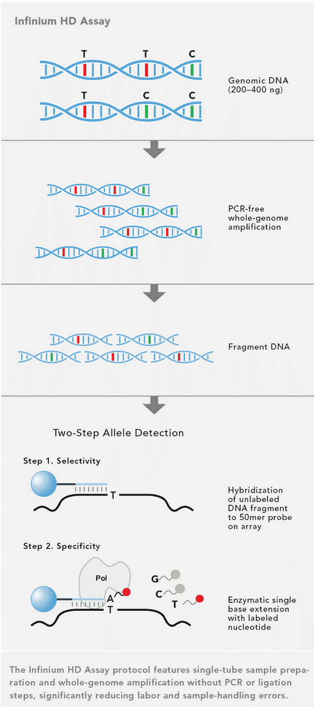
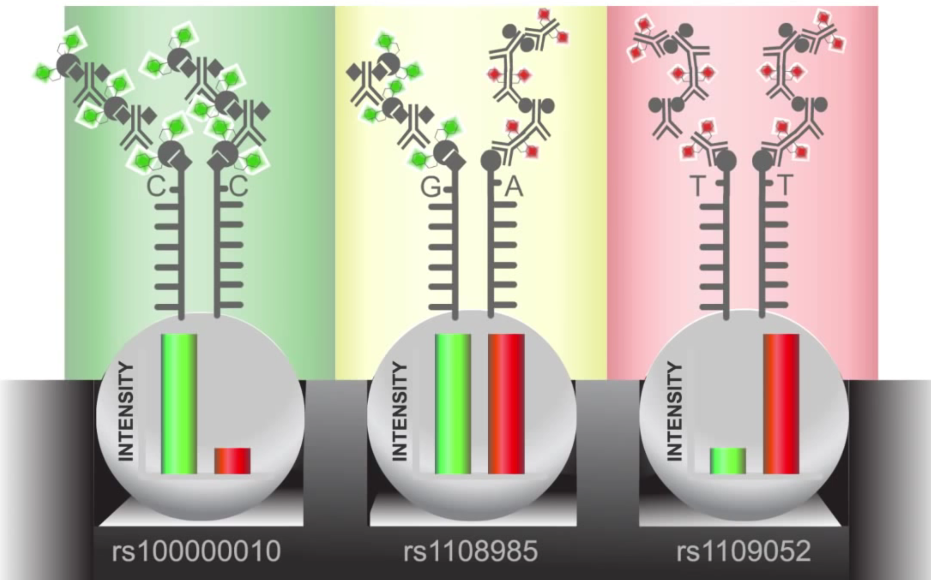
Measuring genotypes
Illumina and Affymetrix
500K ~ 1Million SNPs on chip

Slide 23
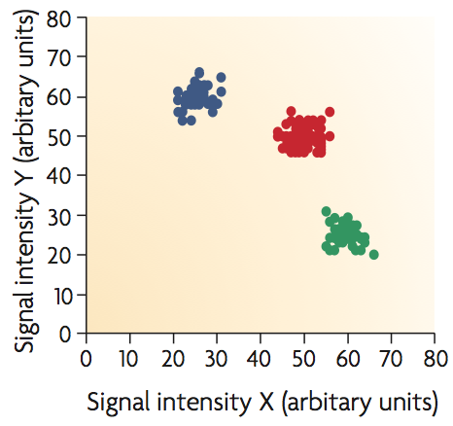
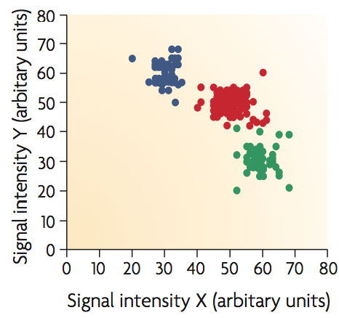
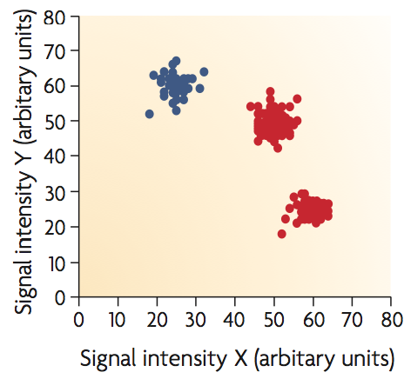
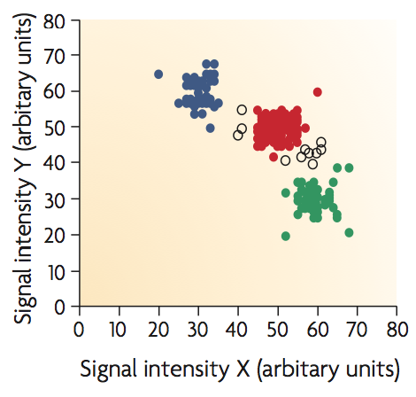
Signal Intensity (cluster) Plots
For analysis of raw genotype intensity data
Can serve as post-hoc QC of genotype data
2 channels – 1 for each allele

Slide 24
Methods for detecting association
Case-control association methods essentially test for independence between trait and allele/genotype.
Quantitative trait loci (QTL) mapping involves identifying genetic loci that influence the phenotypic variation of a quantitative trait.

Slide 25
Estimating power to detect an association
Power = 1- P(type II error)
Type II error = False Negative
Depends on:
Effect size (odds ratio)
Sample size (N)
Required level for significance(α)
Phenotype prevalence
Extent to which tested marker is in LD with the causal marker
GPC Power Calculator
http://pngu.mgh.harvard.edu/~purcell/gpc/
A
Minor Allele Frequency > 0.01
Number of Cases (Controls = 3000)
Notes:
Power = probability of correctly rejecting the null hypothesis

Slide 26
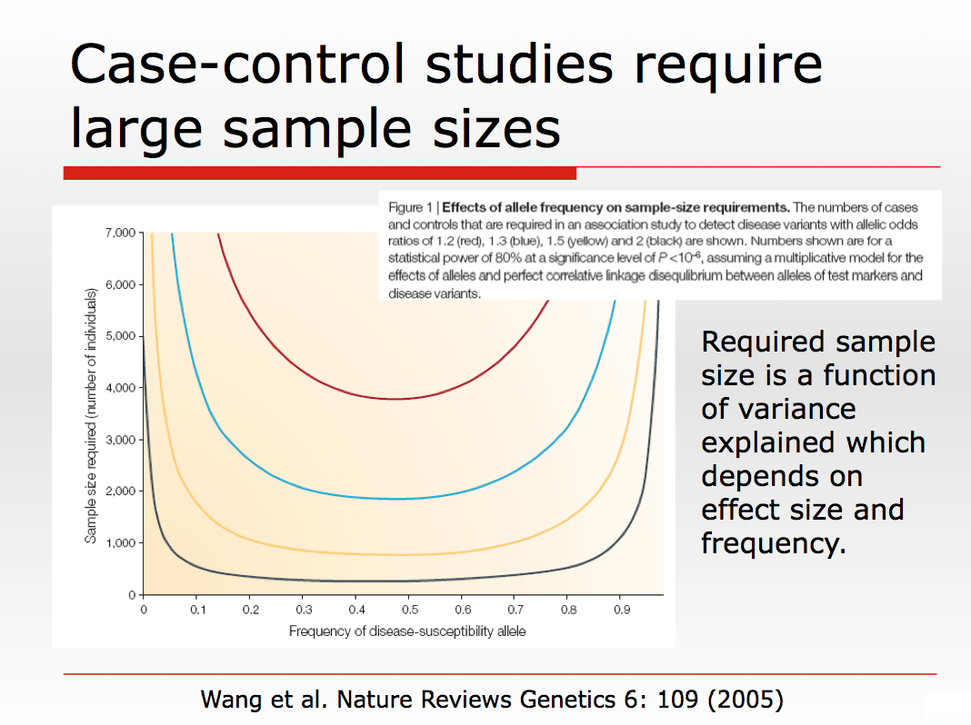

Slide 27
Case-Control association testing
Allelic Association Tests
Allele is treated as the sampling unit
Typically make an assumption of Hardy-Weinberg equilibrium (HWE). Alleles within an individual are conditionally independent, given the trait value.
Genotypic Association Tests
Individual is the sampling unit
Does not assume HWE
Allelic Tests
Allele | Cases | Controls
a
A
Genotypic Tests
Genotype | Cases | Controls
aa
Aa
AA

Slide 28
Case-Control: Commonly used tests
Pearson’s χ2
Fisher’s Exact Test
Armitage Trend Test
Logistic Regression

Slide 29
Pearson’s χ2
Calculate χ2 statistic from allelic contingency table and assess significance
Allele | Cases | Controls
a | n_{a}^{ca} | n_{a}^{co}
A | n_{A}^{ca} | n_{A}^{co}
n_{a}
n_{A}
n^{ca}
n^{co}
T
Expected counts are estimated from the row and column totals:
Allele | Cases | Controls
a | n_{a}*n^{ca}/T | n_{a}*n^{co}/T
A | n_{A}*n^{ca}/T | n_{A}*n^{co}/T
n_{a}
Under H₀, the χ2 test statistic has an approximate χ2 distribution with (r − 1)(c − 1) = (2 − 1)(2 − 1) = 1 degrees of freedom
r = nrows , c = ncols
n_{A}
n^{ca}
n^{co}
T

Slide 30
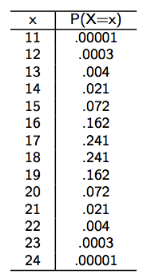
Fisher’s Exact Test
H₀ assumed to follow a hypergeometric distribution
Must choose over Pearson if any cells are < 5
Plug in different X values to get a distribution
Allele | Cases | Controls
a | n_{a}^{ca} | n_{a}^{co}
A | n_{A}^{ca} | n_{A}^{co}
n_{a}
n_{A}
Reject H₀
n^{ca}
n^{co}
T
X = n_{a}^{ca}
Reject H₀
Computationally more expensive than Pearson’s, but that is no longer a practical concern in most cases

Slide 31
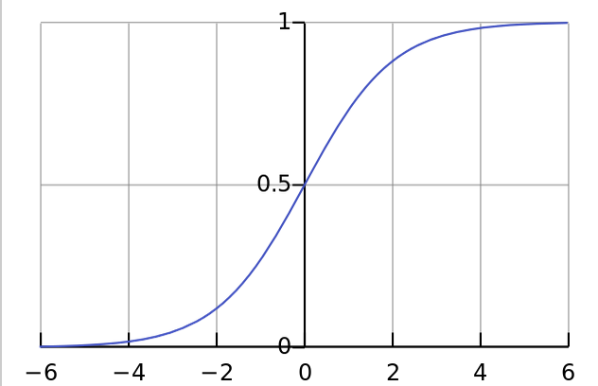
Logistic Regression
Linear regression for binary outcomes
Allows inclusion of covariates
Phenotype
Genotype
Covariate
Logistic function:
H₀: β1 = 0
H_{a}: β1 ≠ 0
Differences from linear regression:
- p(y|x) follows a Bernoulli rather than a Gaussian
- The linear combination of inputs is restricted to fall between 0,1 by the logistic function
Notes:
Y = P(case)
OR (1 unit increase in x) = e^{β1}

Slide 32
QTL association testing
Linear regression
ANOVA

Slide 33
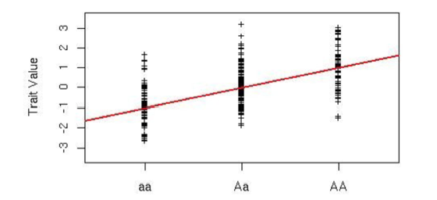
Linear Regression
Most common model for QTL association
Can easily include covariates
Usually fit 1 marker, but can fit several at once
H₀: β1 = 0
H_{a}: β1 ≠ 0
Test statistics
S_{xx} = Corrected Sum of Squares for X_{i}s

Slide 34
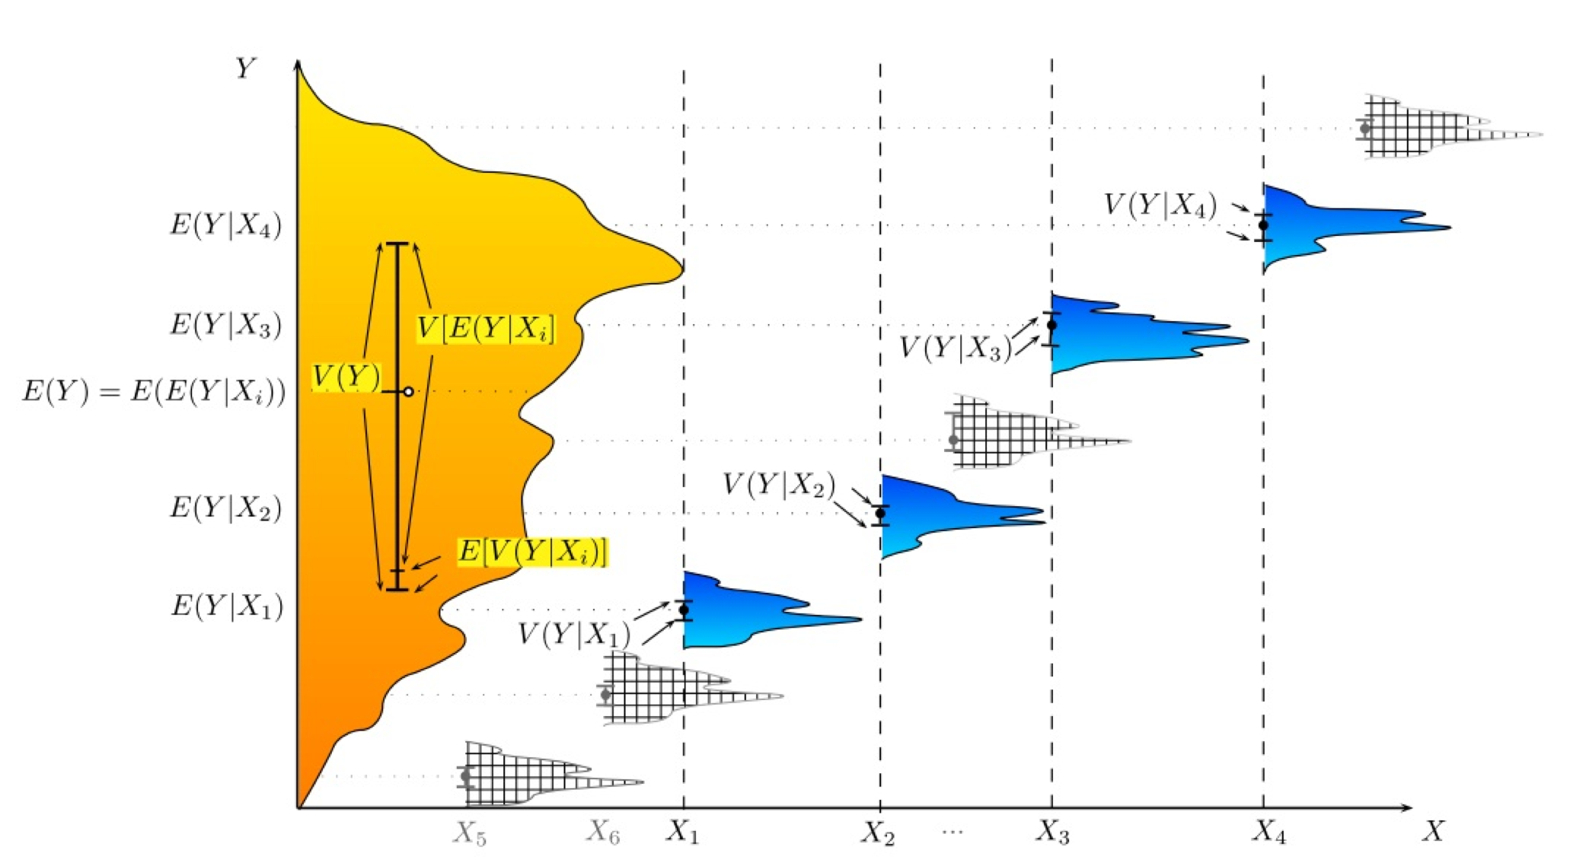
ANOVA
Similar to linear regression, but focuses on comparing groups of samples (within vs between group variance)
For both ANOVA and linear regression, phenotype should be normally distributed for each genotype (AA, Aa, aa) with a common variance
H₀ is essentially that all groups come from a random sample and that phenotypically relevant subpopulations are not present

Slide 35
Linear regression vs ANOVA
ANOVA is the analysis of variation between two or more samples while regression is the analysis of a relation between two or more variables.
ANOVA theory is applied using three basic models (fixed effects model, random effects model, and mixed effects model) while regression is applied using two models (linear regression model and multiple regression model).
ANOVA and Regression are both two versions of the General Linear Model (GLM). ANOVA is based on categorical predictor variables, while regression is based on quantitative predictor variables.
Regression is the more flexible technique, and it is used in forecasting and predicting while ANOVA is used to compare the equality of two or more populations.

Slide 36
Basic ANOVA Models
Fixed effects models
Assumes the levels of X are fixed (i.e. take on a set of values that are known and not a random sample of the parameter space)
Usually used to model genotypes (aa, Aa, AA)
Random Effects models
Assumes that X represents a random sample from the larger universe and that not all possible values are represented
Mixed Effects models
Includes both fixed and random effects
Fixed: genotype, gender
Random: environment, degree of relatedness between individuals in the cohort

Slide 37
Evaluating Association Results
QQ-Plots (quantile-quantile plots)
Manhattan Plots
Signal intensity (cluster) plots

Slide 38
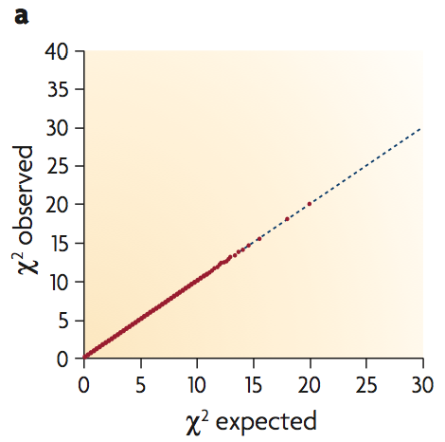
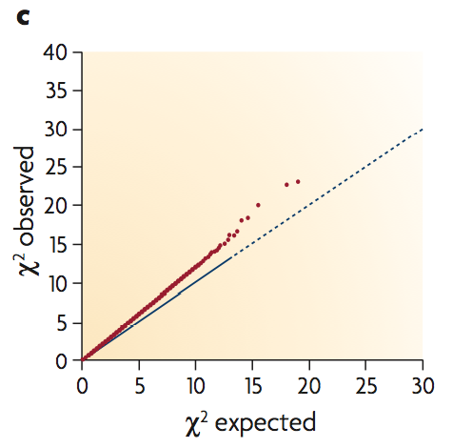
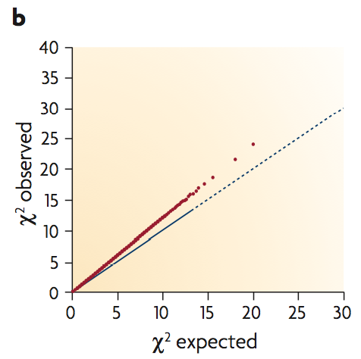
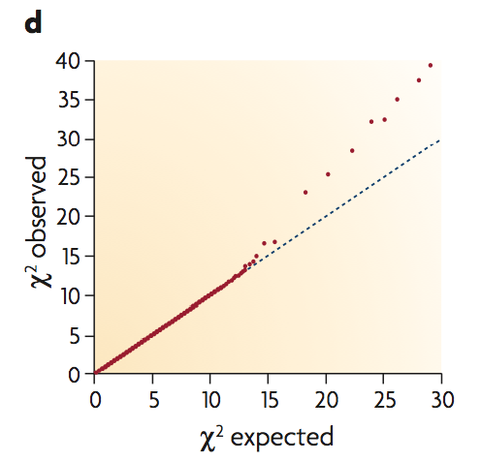
QQ plots
Plot observed statistic against expected statistic, both sorted in increasing order

Slide 39
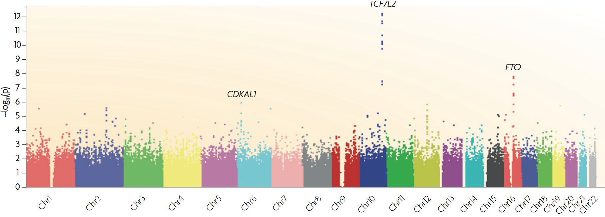
Manhattan Plots
Plot –log10(pvalue) versus increasing genomic coordinate
Multiple testing correction: p < 5e⁻⁸
Notes:
WTCC Type 2 Diabetes Study

Slide 40
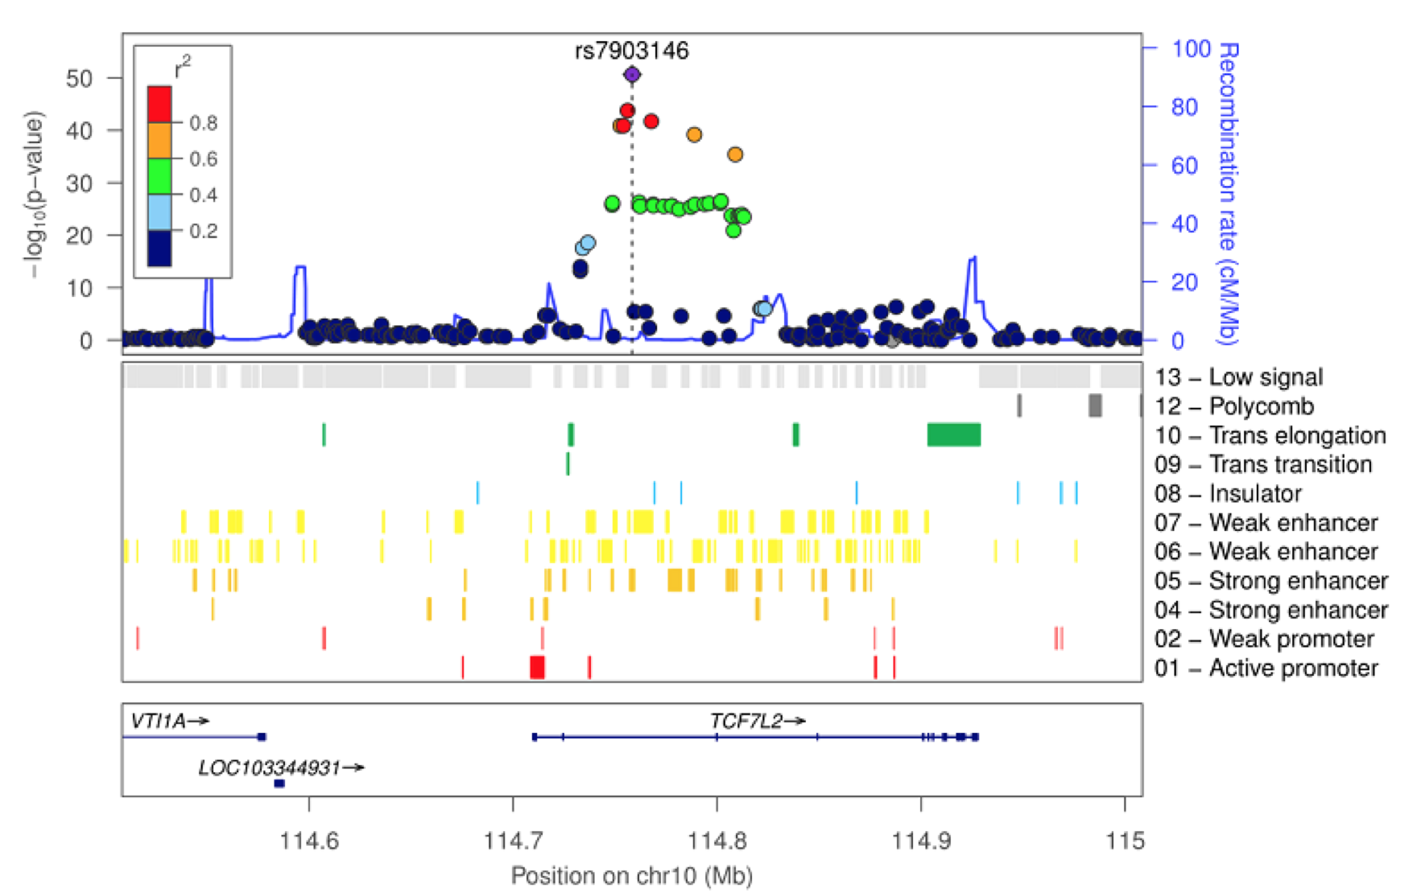
Locuszoom
http://csg.sph.umich.edu/locuszoom/

Slide 41
Break

Slide 42
Other considerations for GWAS
Disease Model
Environment
Epistatic effects
Interactions between genotypes

Slide 43
Disease models
Disease model
Additive
Dominant
Recessive
2 Degrees of Freedom

Slide 44
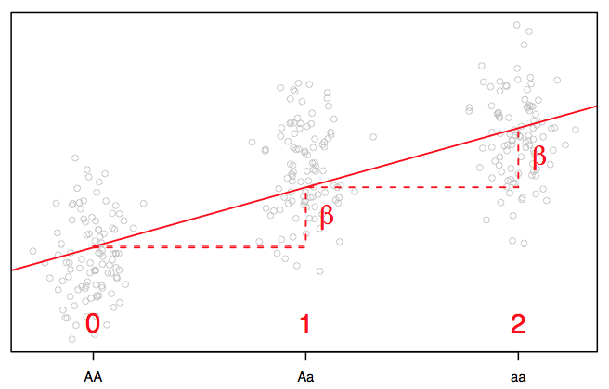
Linear Regression: Additive Model
X = # of minor alleles
Phenotype
Genotype

Slide 45
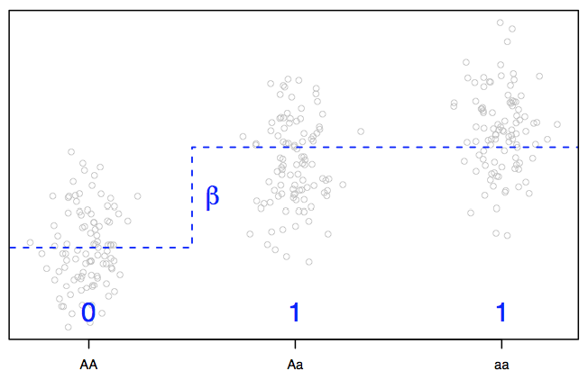
Linear Regression: Dominance Model
X = I(G ≠ AA)
Phenotype
Genotype

Slide 46
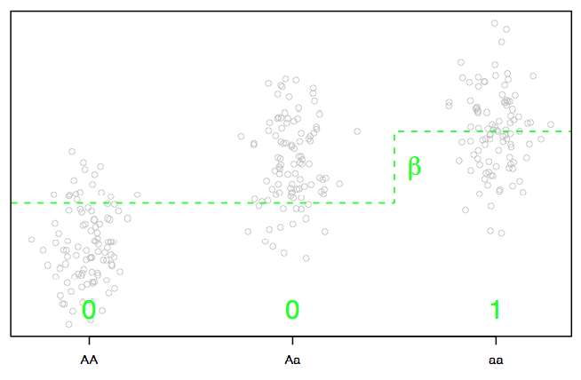
Linear Regression: Recessive Model
X = I(G == aa)
Phenotype
Genotype

Slide 47
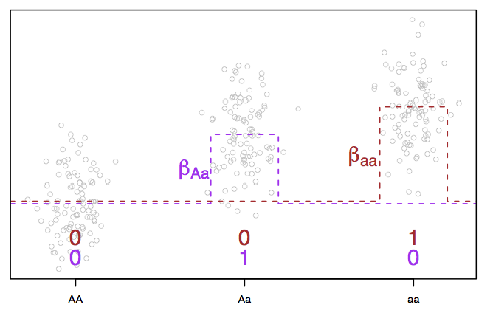
Linear Regression: 2 DF Model
Phenotype
Genotype

Slide 48
Complicating factors
Variation in quantitative traits arises from the combined effects of:
Genes at multiple loci (locus heterogeneity)
Pleiotropy (one gene having many effects)
Epistasis (different genes interacting)
Environmental effects (genes produce a range of phenotypes, depending upon the environment - phenotypic plasticity and reaction norms)

Slide 49
Environment
Phenotypic variance is caused by both genetic variance and environmental variance, but also by the interaction of the two
V_{p} = V_{g} + V_{e}+ V_{g} x V_{e}
Strategy: Include terms for environment and gene x environment interactions explicitly in the model
In practice, environmental factors may or may not have been measured for the cohort
Examples of environmental factors:
Exposures (cigarette smoke, caffeine, UV radiation, asbestos …)
Family
Diet
Location

Slide 50
Epistasis
Interactions between loci
Need both genotypes for effect on phenotype
Can model pairs of SNPs
Huge test space
Different from locus heterogeneity
Also model multiple SNPs but each SNP would explain some fraction of the samples with the trait

Slide 51
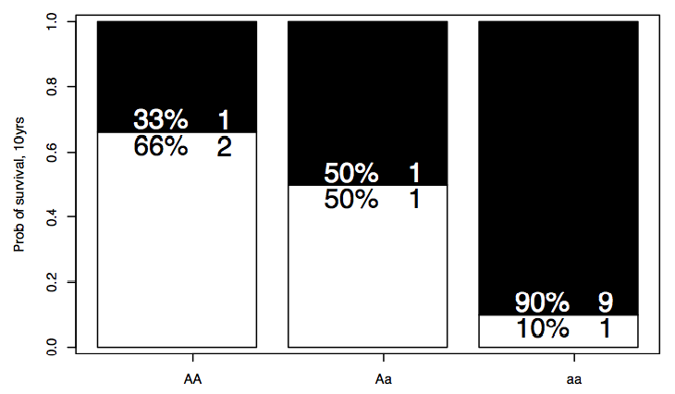
Odds Ratios
Gambling friendly measure of chance
Probability of
death
Odds of death

Slide 52
Odds Ratios by Allele Counting
 | Disease | Healthy
T | D_{T} | H_{T}
C | D_{C} | H_{C}
N_{T}
N_{C}
Relative Risk
Odds Ratio
Risk of getting the disease if you have the T allele relative to getting it if you carry the C allele
Odds of disease with C allele versus odds of disease with T allele
Notes: If the disease is rare, then OR ≈ RR
An OR = 1 implies no disease association, an OR ≠ 1 implies disease association

Slide 53
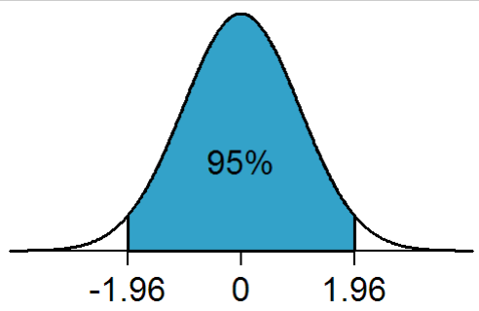
Odds Ratios for Genotypes
You can also use logistic regression to get ORs and confidence intervals
Let π_{i} be the probability that individual i with genotype G_{i} at a SNP is affected with the disease. Then:
 | Disease | Healthy
TT | D_{TT} | H_{TT}
CT | D_{CT} | H_{CT}
CC | D_{CC} | H_{CC}
The coefficients of the genotypes serve as estimates of the OR
OR_{CT} =e^{βCT}
OR_{TT} =e^{βTT}
Indicator Function
To get the 95% confidence interval:
e^{(βCT ± 1.96 * s.e.(βCT))}

Slide 54
Tools for association testing
R
chisq.test(), fisher.test(), prop.trend.test(), lm(), anova()
PLINK
Includes a number of tests for multiple disease models
--assoc, --assoc fisher, –linear, --logistic
GCTA
Tools for fitting mixed effects models

Slide 55
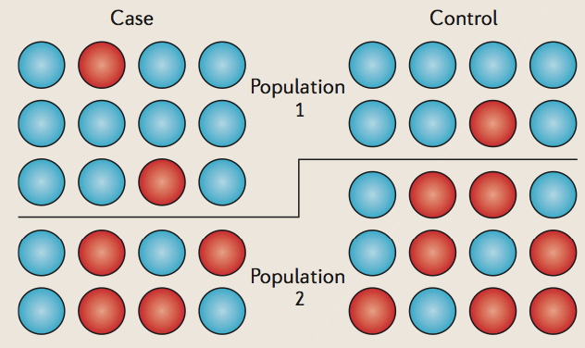
Population substructure
Intuition
Effect sizes resulting from population level differences are often much larger than effect sizes resulting from the phenotype of interest
Consequences
High false positive prediction rates

Slide 56
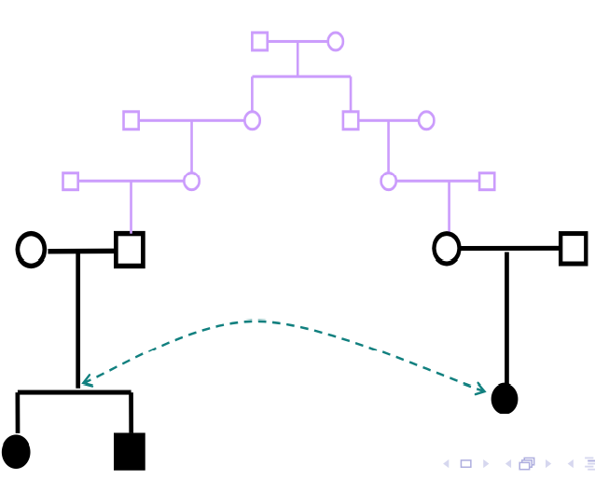
Incomplete Genealogies
Many statistical methods for genetic data, e.g. linkage and association methods, are based on assumptions of independent samples or samples with known relationships.
Can invalidate statistical analyses

Slide 57
Measures of Relatedness
Identity-by-descent (IBD)
parent-offspring share 50% of the genome
siblings share ~ 50% of the genome
aunt/uncle – niece/nephew share ~ 25 % of the genome
Cannot directly observe this. Can only observe DNA sequence / Genotypes
Identity-by-State (IBS)
IBS distance between 2 individuals: (IBS(2) + 0.5*IBS(1)) / ( N SNP pairs )

Slide 58
Controlling for population substructure
Data QC
Check for relatedness and remove 1 from each pair of samples that are closely related
Can find signs of contamination
e.g. 1 sample closely related to a large number of samples
Study design
Start from a highly homogeneous cohort
Principal components
Include population substructure as a fixed effect
Mixed effects models
Include population substructure as a random effect

Slide 59
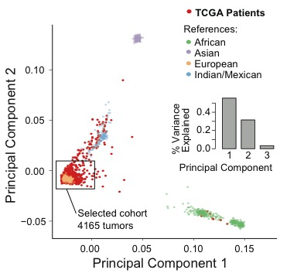
Principal component analysis
Perform PCA using a set of independent SNPs
Include PCs as covariates during regression

Slide 60
Mixed effects models
Instead of using PCs, include a genetic relationship matrix as a random effect in a mixed effects model
Strategy used by GCTA software package
http://www.complextraitgenomics.com/software/gcta/
And A is the genetic relationship matrix (GRM)

Slide 61
Exercises
FST Measures of population divergence
Case-Control Association Study Excercise
Quantitative Association Study Exercise
Plink Tutorial
http://pngu.mgh.harvard.edu/~purcell/plink/tutorial.shtml
Tutorial deals with general plink functionality as well as dealing with population substructure

